Slide 1
Subtraktive Synthese

Slide 2
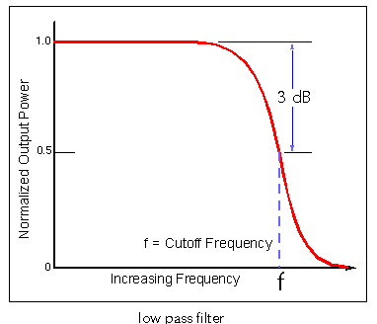
Lowpass Filter

Slide 3
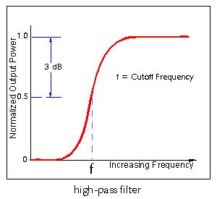
Highpass Filter

Slide 4
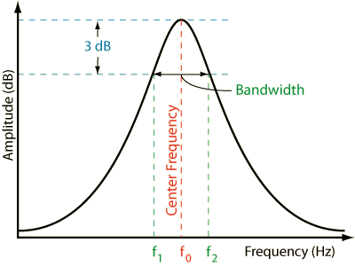
Bandpass Filter

Slide 5
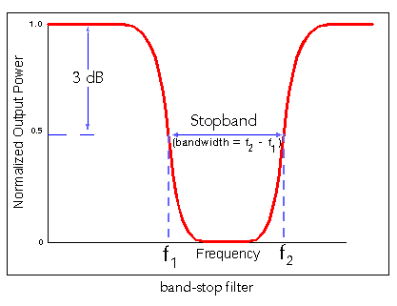
Band Reject Filter (Notch Filter)

Slide 6
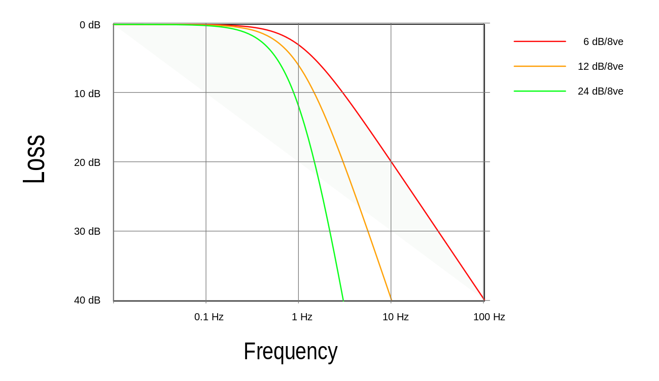
Flankensteilheit - Ordnung

Slide 7
György Ligeti, Atmosphères (1961)

Slide 8
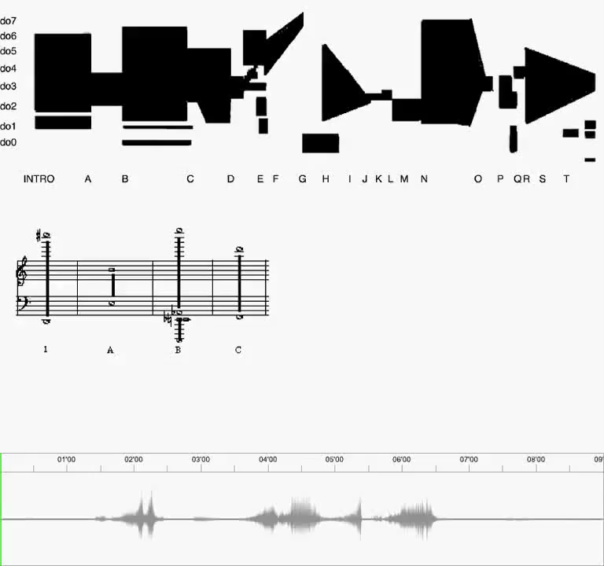
György Ligeti, Atmosphères (1961)

Slide 9
Friedrich Cerha, Spiegel II (1961-63)

Slide 10

Friedrich Cerha
Spiegel II
(1961-63)

